Slide 1

DEPARTMENT OF ELECTRICAL ENGG
Matoshri Institute of Technology
Dhanore, Tal-Yeola, Dist. –Nasik (Maharashtra) -423401
(Approved by AICTE, New Delhi, DTE Mumbai)
E-mail: mityeola@gmail.com Website:www.mityeola.com
Project Name: Touchless Door Bell
Group Member : Gomladu Rutik Santosh
Gaikawad Pavan Prashant
Bhad Kiran Sachin
Guided Name: Miss. Beldar G.N

Slide 2
INDEX
Abstract
Introduction
Object
Block Diagram
Working
Component
Advantages
Application
Reference

Slide 3
ABSTRACT
By leveraging proximity sensors, this system allows users to activate the doorbell without physical contact, reducing the risk of transmission of germs and improving accessibility for individuals with mobility challenges.

Slide 4
INTRODUCTION
The Touchless Doorbell is a modern and hygienic solution designed to replace conventional push-button doorbells. In traditional systems, visitors must physically press the switch to ring the bell, which can lead to the spread of germs and viruses.
The global pandemic has increased awareness about touch-free technologies that promote better hygiene. This project aims to create a safe and convenient alternative that operates without any physical contact. The system works using sensors such as infrared (IR) or ultrasonic detectors to sense motion or hand gestures.

Slide 5
OBJECTIVES
Enhance Convenience: They offer hands-free operation, which is useful for visitors carrying items or for those who might otherwise struggle to find or reach a traditional button.
Improve Accessibility: Touchless systems benefit individuals with limited mobility, disabilities, or the elderly for whom reaching or pressing a traditional doorbell may be a challenge.
Integrate with Smart Home Technology: New systems often aim to seamlessly integrate with smart home ecosystems, enabling features like smartphone notifications, video surveillance, remote communication with visitors, and even automatic door unlocking.
Increase Security: By incorporating advanced features like motion detection, video cameras, facial recognition, and remote alerts, the systems enhance home security by allowing residents to screen visitors before opening the door.

Slide 6
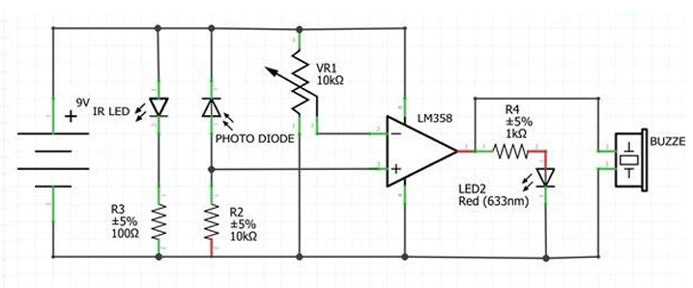
BLOCK DIAGRAM

Slide 7
WORKING
This system uses an infrared transceiver pair and basic components to sense objects and activate the bell when someone stands at the door.
It creates an object-sensing, contactless alternative for ringing doorbells, enhancing both convenience and hygiene.

Slide 8
COMPONENT
9v battery
Buzzer
LM358
10K variable Resistor
IR Rx Tx
Led
Zero PCB
Resistor

Slide 9
ADVANTAGES
Hygienic and Safe: No physical contact is needed, reducing the spread of germs and viruses.
Convenient Operation: Visitors can ring the bell just by waving their hand — quick and easy to use.
Energy Efficient: Many touchless doorbells use low power or motion sensors that consume very little energy.
Modern and Smart Look: Gives a stylish, modern appearance to homes or offices.
Integration with Smart Devices: Can be connected to smartphones or smart home systems for notifications and video streaming

Slide 10
APPLICATION
Residential Homes: Used at the main door to provide hygienic and convenient visitor alerts.
Offices and Commercial Buildings: Ensures contactless entry for employees and visitors.
Hospitals and Clinics: Helps maintain hygiene and prevent infection spread.
Schools and Colleges: Used at main gates or staff rooms for touch-free operation.
Hotels and Restaurants: Enhances customer experience with modern, hygienic door systems.

Slide 11
REFERENCES
https://youtube.com/shorts/I964cbLAfAM?si=bR2VGQixXDRnIHKw
https://youtube.com/shorts/yIQmBMLl_b0?si=Sh4FrdXk-qwLjW-g
https://youtu.be/A-WQ8ikMZUQ?si=V7_NcfzIrMuobEVn
https://youtu.be/Vgsb9PGus9Q?si=K-cruh3sCuDLRqCk

Slide 12
THANK YOU

